Slide 1
C.R.I.M.E Attack
Compression leaks!

Slide 2

What’s wrong with C⊕E?
len(E(C(s)) is leaked!

Slide 3
Agenda
01
02
03
Abstract
C.R.I.M.E
C.R.I.M.E
04
CTF
Compression is bad (for secrecy)
Concept & History
Implementation details
Challenge Description & Live Demonstration

Slide 4
C.R.I.M.E
Compression reduces data based on repetition
When compressed before encrypted, the compressed length is exposed
Length can be used as a side channel attack vector
Exposes CPA-vulnerable browsers (XSS) to session hijacking

Slide 5
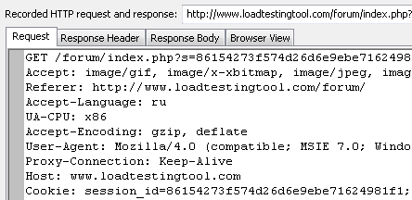
C.R.I.M.E
Guess content by observing encrypted size
Make targeted guess to advance the guess further
Use patterns in HTTP for session hijacking

Slide 6
C.R.I.M.E - History
Hypothesised August 2011, demonstrated a year~ later
Relies on pattern matching used by DEFLATE
Was Effective against SPDY (compressed headers), TLS (may compress)
Mitigated in TLS by disabling compression

Slide 7

C.R.I.M.E - Implementation Details
Start guessing from “ cookie = “ + (r ~ (0..=255))
Next guess : argmin(Oracle(P)) + (r ~ (0..=255))
Until the session token is uncovered!
If you’re lucky…

Slide 8
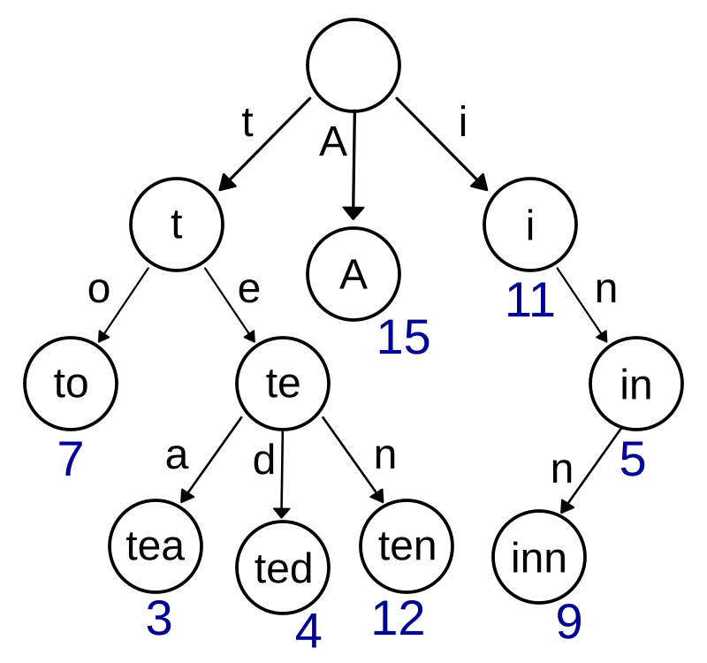
C.R.I.M.E - Implementation Details
The compression induces ‘noise’
How to resolve a tie?
You might choose the wrong path and dead end.
Solution - use DFS/recursion

Slide 9
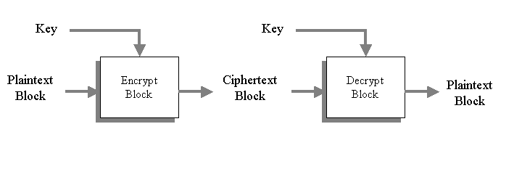
C.R.I.M.E - Block vs. Stream Ciphers
RC4: |E(s)| == |s|
Not the case with block ciphers (AES)
Come up with a solution ! (hint - it’s simple)

Slide 10
https://github.com/avivyossef29/Crypto-Project/blob/main/crime/crime_report.pdf

